Slide 1


Bank Loan Case Study
Final Project – II
By Meghneel Gogoi Trainity Data Analytics Trainee

Slide 2
Project Description
The primary goal of this project is to analyze customer loan data to identify patterns and key factors that contribute to loan defaults. By understanding these patterns and using Exploratory Data Analysis (EDA) , the company can improve its decision-making process for loan approvals, reduce the risk of defaults, and ensure that capable applicants are not unfairly rejected.
When a customer applies for a loan, your company faces two risks:
If the applicant can repay the loan but is not approved, the company loses business.
If the applicant cannot repay the loan and is approved, the company faces a financial loss.
When a customer applies for a loan, there are four possible outcomes:
Approved: The company has approved the loan application.
Cancelled: The customer cancelled the application during the approval process.
Refused: The company rejected the loan.
Unused Offer: The loan was approved but the customer did not use it.

Slide 3
Approach
Importing and understanding the data sets provided.
Cleaning data and identifying missing values and dealing with them appropriately.
Performing analysis and showing insights.
Visualizing the analysis and insights through graphs and charts.
Concluding the project with actionable insights which can benefit the bank.

Slide 4
Tech Stack
Microsoft Excel 365
Excel is a powerful spreadsheet software developed by Microsoft, widely used for data organization, analysis, and visualization. It allows users to create, edit, and manage spreadsheets that consist of cells arranged in rows and columns. Each cell can contain data, formulas, or functions that perform calculations and manipulate data.
EXCEL LINK:
https://docs.google.com/spreadsheets/d/1IqUmO_SSRWh9ArhwyauNeEv-KTNSqovD/edit?usp=drive_link&ouid=117119704857987901939&rtpof=true&sd=true
VIDEO LINK:
https://youtu.be/vrdwvAPPH-Y
PowerPoint
PowerPoint is a presentation software developed by Microsoft that allows users to create, design, and deliver visual presentations. It is part of the Microsoft Office suite and is widely used in business, education, and other fields to convey information in a structured and visually appealing way.

Slide 5
Understanding data
Application_data:
COLUMNS | COLUMNS WITH NULL | ROWS
122 | 64 | 50000
Previous_application:
COLUMNS | COLUMNS WITH NULL | ROWS
37 | 15 | 50000

Slide 6
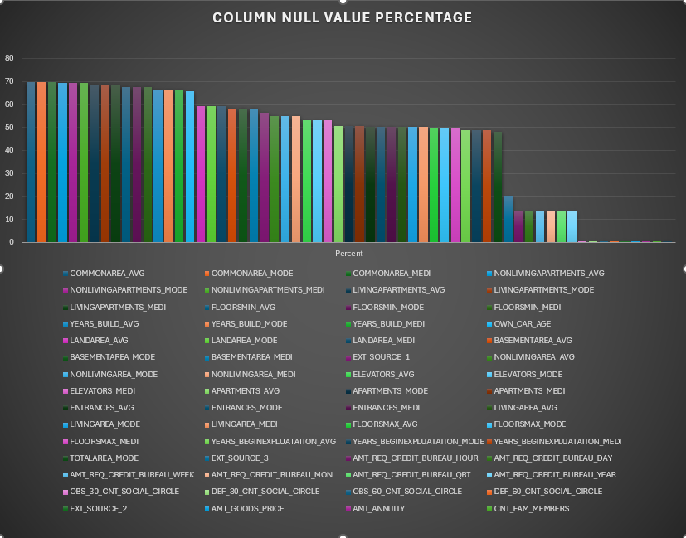
INSIGHTS
A. Identify Missing Data and Deal with it Appropriately: Identify the missing data in the dataset and decide on an appropriate method to deal with it using Excel built-in functions and features.
application_data: This dataset had the following columns with null values with their percentage shown in the graph.
this was done using `=COUNTBLANK` function and converting the count value of each columns to percentage using simple mathematics.
Columns with NULL values percentage more than 40% was removed from the dataset since the quantity of these missing data was a lot to go ahead with the analysis.
While, columns with NULL value percentage less than 40% were filled using median/mode imputation.
Columns removed:
COMMONAREA_AVG
COMMONAREA_MODE
COMMONAREA_MEDI
NONLIVINGAPARTMENTS_AVG
NONLIVINGAPARTMENTS_MODE
NONLIVINGAPARTMENTS_MEDI
LIVINGAPARTMENTS_AVG
LIVINGAPARTMENTS_MODE
LIVINGAPARTMENTS_MEDI
FLOORSMIN_AVG
FLOORSMIN_MODE
FLOORSMIN_MEDI
YEARS_BUILD_AVG
YEARS_BUILD_MODE
YEARS_BUILD_MEDI
OWN_CAR_AGE
LANDAREA_AVG
LANDAREA_MODE
LANDAREA_MEDI
BASEMENTAREA_AVG
BASEMENTAREA_MODE
BASEMENTAREA_MEDI
EXT_SOURCE_1
NONLIVINGAREA_AVG
NONLIVINGAREA_MODE
NONLIVINGAREA_MEDI
ELEVATORS_AVG
ELEVATORS_MODE
ELEVATORS_MEDI
APARTMENTS_AVG
APARTMENTS_MODE
APARTMENTS_MEDI
ENTRANCES_AVG
ENTRANCES_MODE
ENTRANCES_MEDI
LIVINGAREA_AVG
LIVINGAREA_MODE
LIVINGAREA_MEDI
FLOORSMAX_AVG
FLOORSMAX_MODE
FLOORSMAX_MEDI
YEARS_BEGINEXPLUATATION_AVG
YEARS_BEGINEXPLUATATION_MODE
YEARS_BEGINEXPLUATATION_MEDI
TOTALAREA_MODE

Slide 7
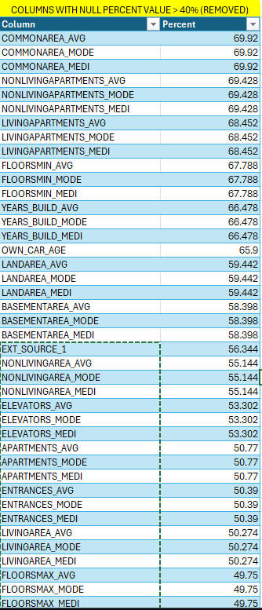
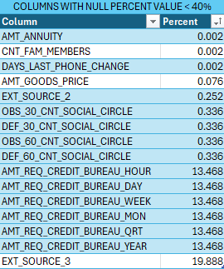
Pivot table was used to calculate these values. COLUMNS WITH >40% NULL VALUES : DROPPED COLUMNS WITH <40% NULL VALUES: IMPUTATION

Slide 8
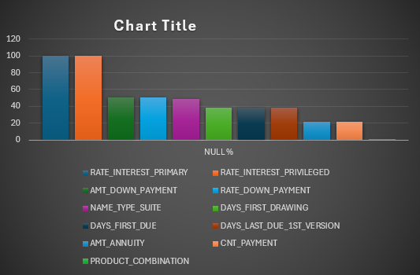
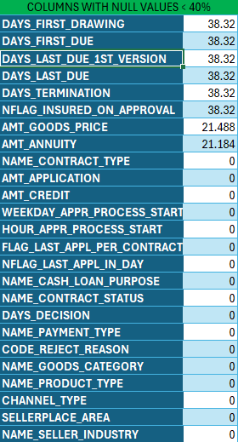
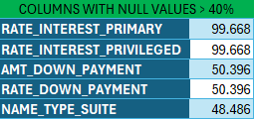
previous_application: this dataset had the following columns with NULL values.
Columns with null values > 40% are dropped
Columns with null values < 40% median-mode imputation

Slide 9
Handling missing values through median/mode imputation.
I used descriptive statistics from excel to perform functions to find average, median and mode to fill in the missing values.
Numerical variables: these are the variables with numerical values and to impute missing values in here we use average or median depending on the range and distribution of the data.
Ex:- AMT_ANNUITY, AMT_CREDIT, AMT_INCOME_TOTAL. Missing values in these columns were filled using median imputation Categorical variables: these are the variables with non-numerical values and to impute missing values in here we use mode.
Ex:- NAME_CONTRACT_TYPE, NAME_TYPE_SUITE. Missing values in these types of columns were filled using mode imputation

Slide 10
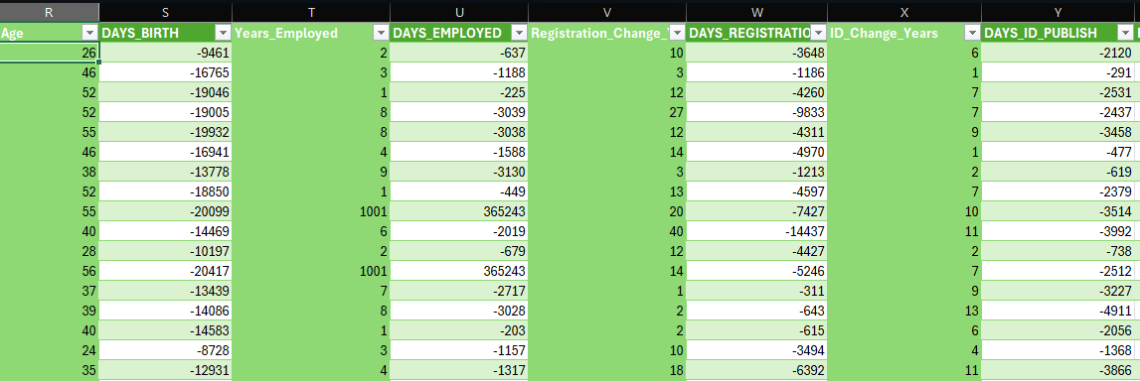
Columns days_birth, days_employed, days_registration, days_id_publish had days in wrong format with “-” sign. Wrong format as such was fixed using the following formula given below
`=ROUND((ABS(S2)/365),0) `
The days were converted into absolute value and divided by 365 to convert into years making the data more visibly appeasing.

Slide 11
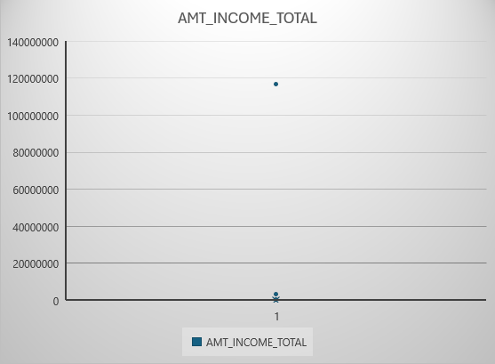
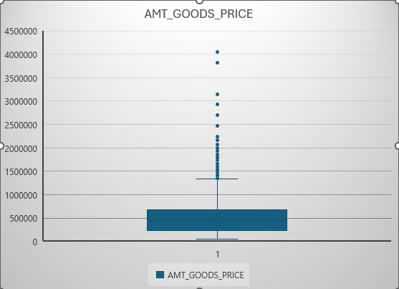
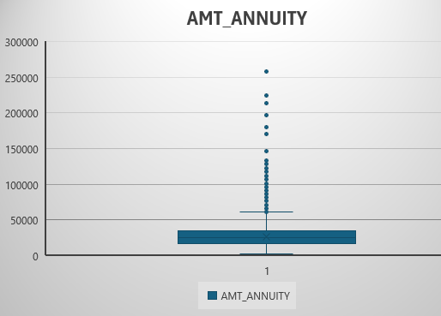
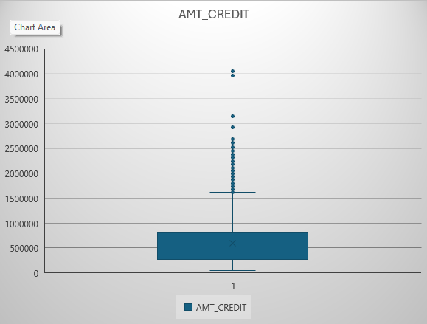
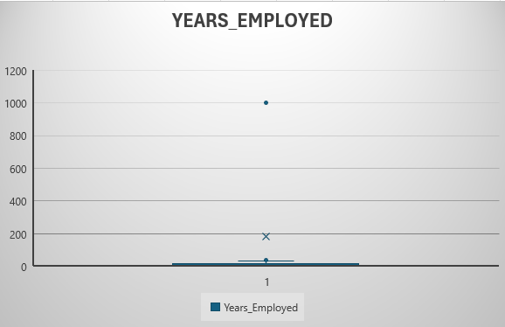
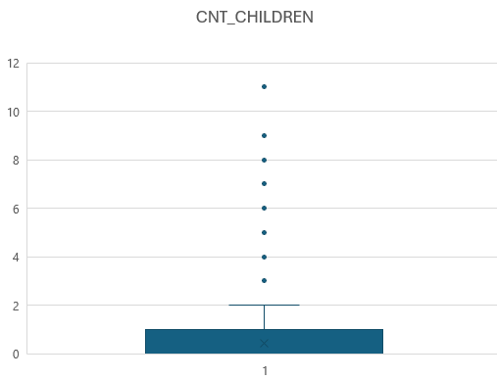
B. Identify Outliers in the Dataset: Detect and identify outliers in the dataset using Excel statistical functions and features, focusing on numerical variables.
Application_data

Slide 12
Outlier investigation
Amt_income_total: one income outlier >100000000 (100 mil) requires investigation
Years_employed: outliers consisting of 1001 years is physically impossible.
Cnt_children: outliers of 9+ children in today’s age needs further investigation.

Slide 13
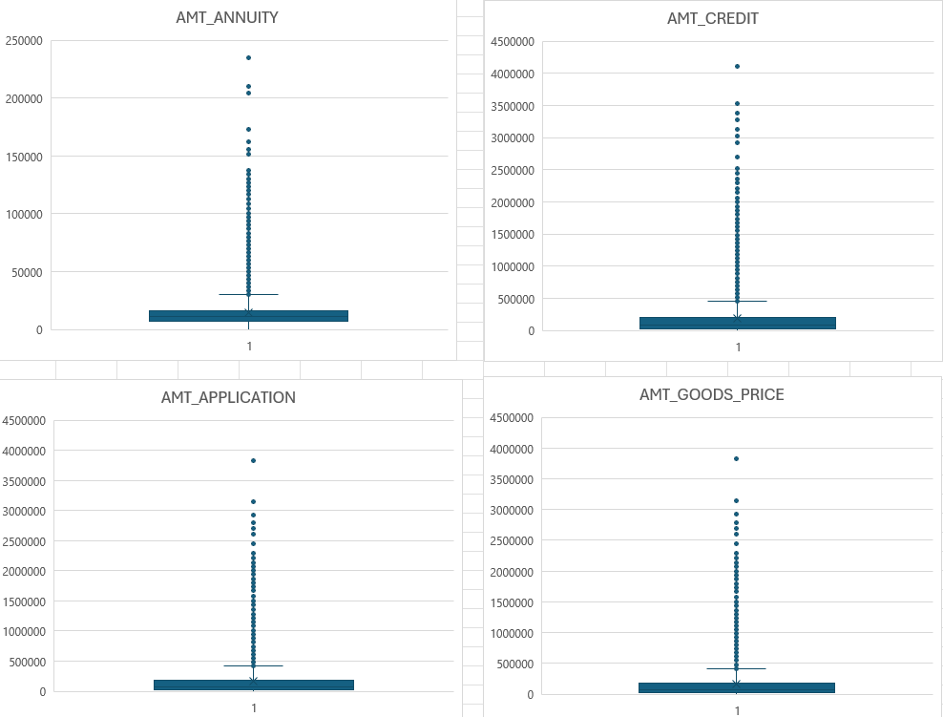
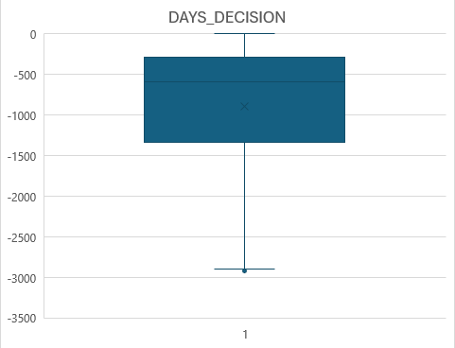
Previous_application

Slide 14
Outlier investigation
Days_decision: one outliers detected around -3000 days which is around 8 years, which is too much of days in between the current and previous application.
Some outliers detected for amt_annuity, amt_application, amt_credit, amt_goods_price.

Slide 15
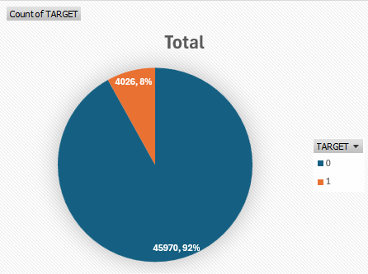
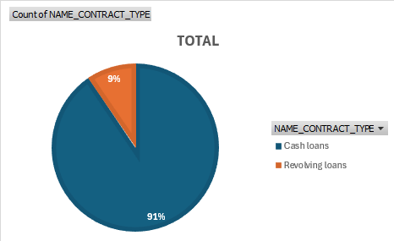
C. Analyze Data Imbalance: Determine if there is data imbalance in the loan application dataset and calculate the ratio of data imbalance using Excel functions.
Application_data
1 : Defaulters 0 : Non-Defaulters
From the graph we can see the ratio of defaulters and non-defaulters is very highly disproportional.
92% are non-defaulters and 8% are defaulters. This shows high data imbalance.
Analysis on defaulters may face challenges due to such small sample size from the dataset.
From the graph we can see the ratio of cash loans and revolving loans.
91% cash loans and 9% revolving loans signify a high data imbalance in the dataset.

Slide 16
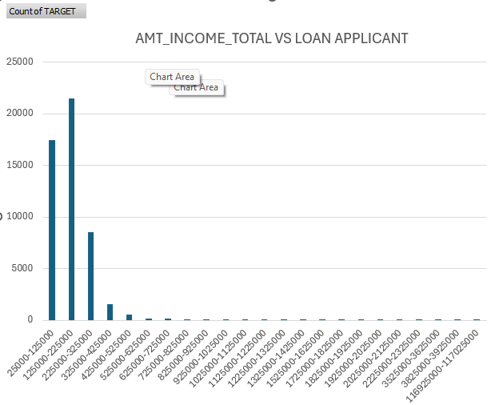
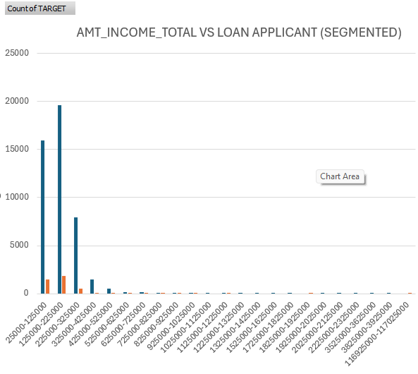
D. Perform Univariate, Segmented Univariate, and Bivariate Analysis: Perform univariate analysis to understand the distribution of individual variables, segmented univariate analysis to compare variable distributions for different scenarios, and bivariate analysis to explore relationships between variables and the target variable using Excel functions and features.
From both graphs we can see that most of the loan applicants are from 125000-225000 total income category and most of the defaulters are also from there signifying that most people belong to that income category and some case of defaulters are bound to happen no matter what. There was only one from 116925000+ income category which is exceedingly high compared to norms and it was a defaulter.

Slide 17
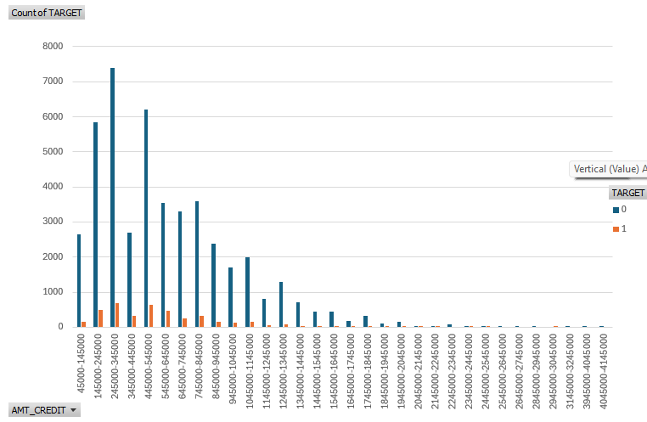
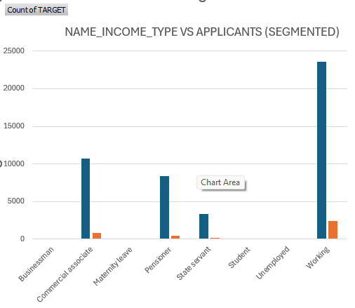
This is the AMT_CREDIT vs LOAN APPLICANT graph with defaulters and non defaulters segmented.
Most loan amount taken were 245000-345000 credit range.
Most of the loan defaulters belong to the 245000-345000 and 445000-545000 category.
the highest amount loan with defaulter is 29450000-30450000 credit range.
The name_Income_type graph shows most of the loans are taken from the working class and most loan defaulters are also from the working class.
Businessman and students have 0 loan defaulters but their sample size is also small.
Unemployed has the highest loan defaulter percentage with 6 loans taken and 2 of them were loan defaulters.

Slide 18
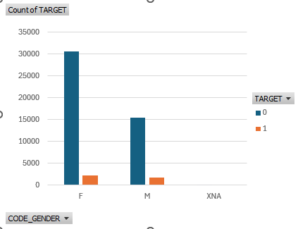
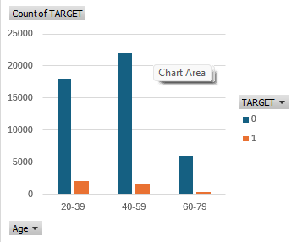
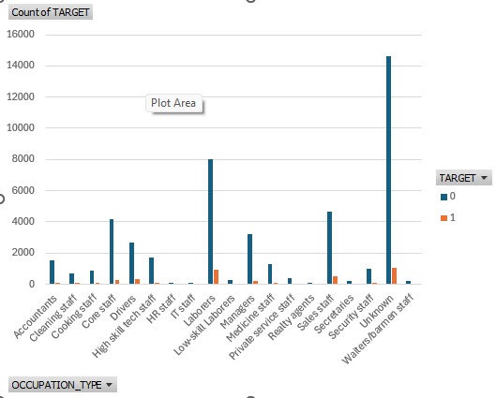
AGE VS LOAN APPLICANT
OCCUPATION TYPE VS LOAN APPLICANT
GENDER VS LOAN APPLICANT
As age increases the number of cases of defaulters decreases. Bank should prioritize giving loans to elder people.
Most of the defaulters are from labourer occupation type and unknowns.
Most loans were taken from females. The ratio of loans taken between females and males is 2:1. Females have more defaulters but their ratio of defaulter and non-defaulters are better than males.

Slide 19
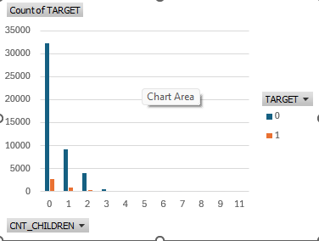
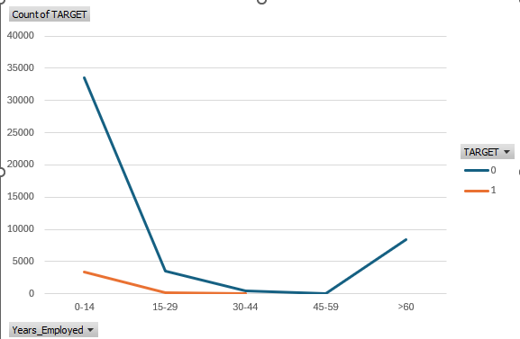
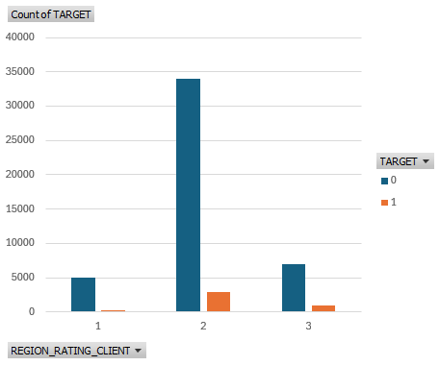
COUNT CHILDREN VS LOAN APPLICANT
YEAR EMPLOYED VS LOAN APPLICANT
CLIENT REGION RATING VS LOAN APPLICANT
The no. of defaulters keep decreasing in count of children till 8, after that there’s a 100% defaulting for 9+ children count.
As years increase the cases of defaulting decrease.
Region rating with 1 have the least amount of defaulters. Region rating with 3 have the most percentage of defaulters.

Slide 20
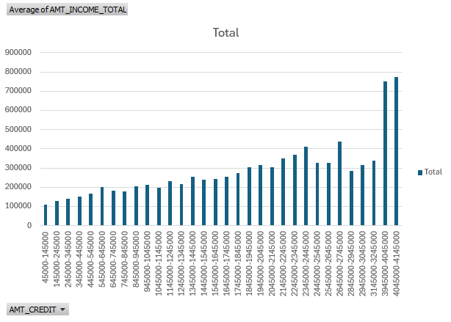
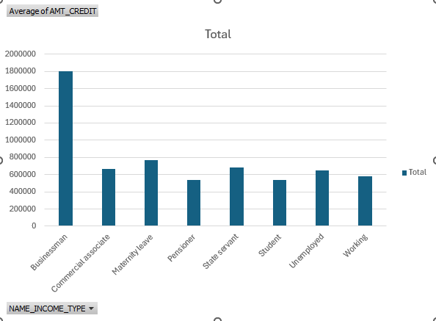
Bivariate Analysis

Slide 21
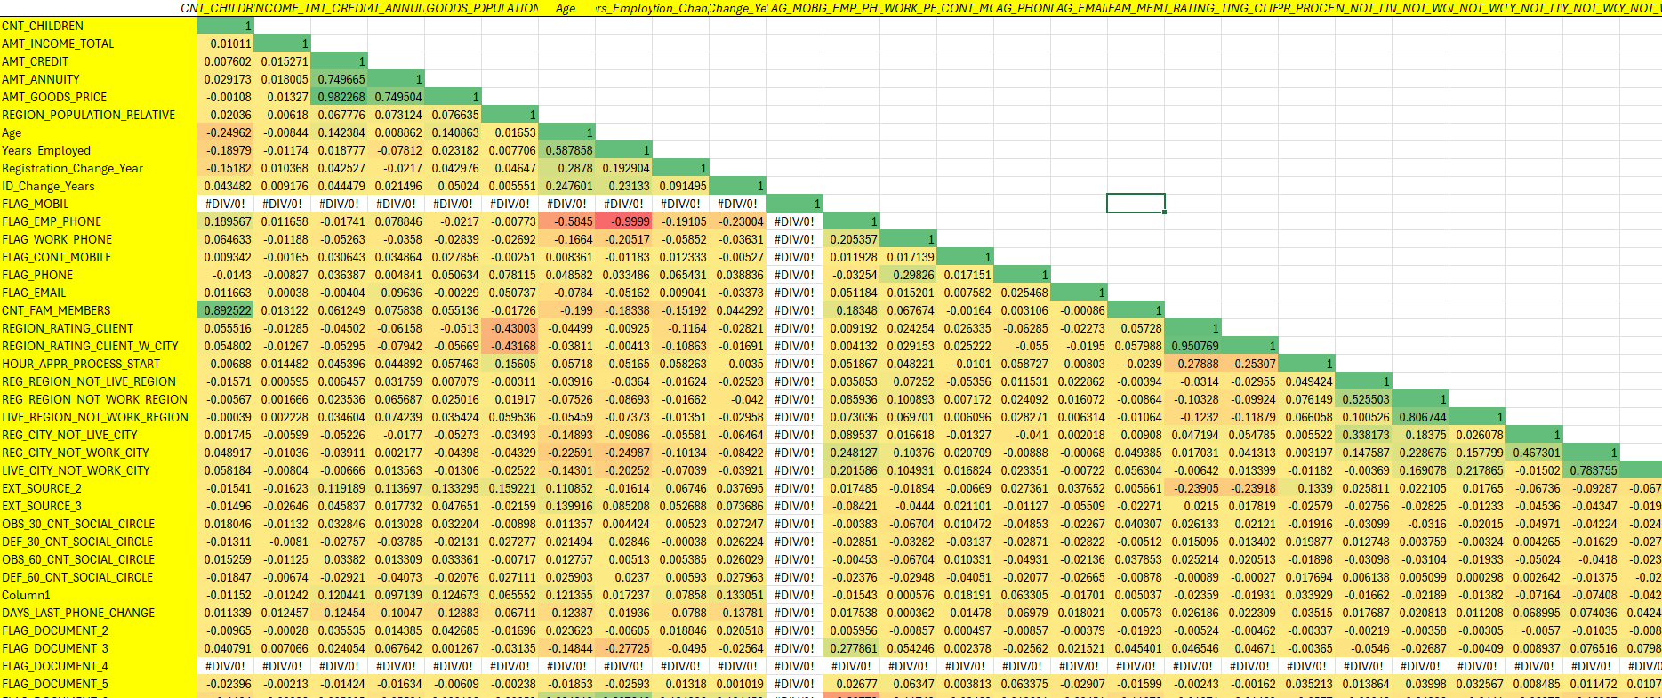
E. Identify Top Correlations for Different Scenarios: Segment the dataset based on different scenarios (e.g., clients with payment difficulties and all other cases) and identify the top correlations for each segmented data using Excel functions.
Correlation matrix of application_data dataset
(defaulters)

Slide 22
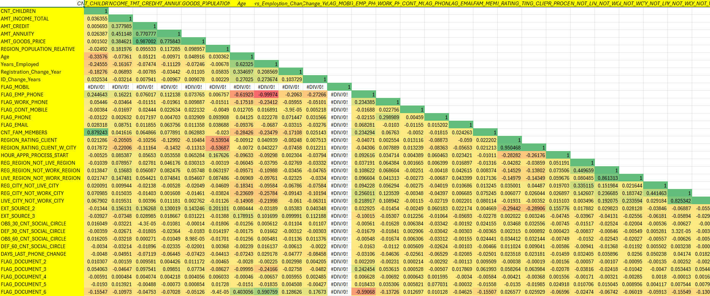
Correlation matrix of application_data dataset
(non-defaulters)

Slide 23
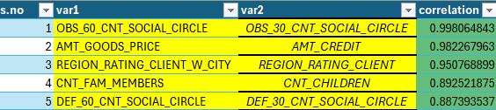
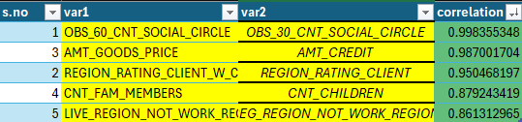
Top correlations
Top correlations of defaulters
Top correlations of non-defaulters

Slide 24
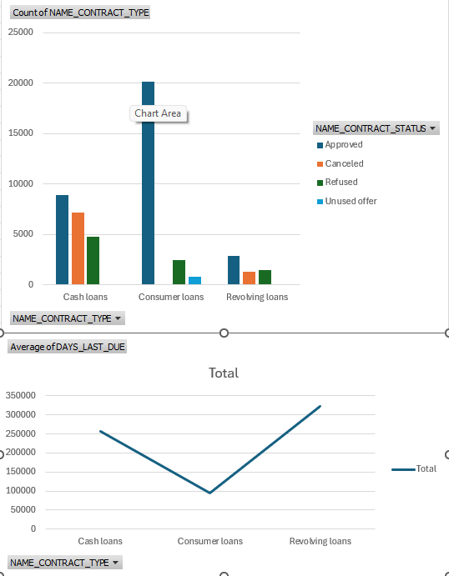
Previous_application additional investigation
Days_last_due: this column measures the difference in days between the application date of the current loan and the last due date of the previous loan. Many of the days were 365423 which is like 100 years, which is impossible so taking it as due not paid we find that in comparison to other types of loans ,consumer loans were more accepted and paid in time.

Slide 25
Suggestions
Bank should prioritize giving loans to females and look into why males are defaulting more.
Banks should prioritize elder people and with more years of experience since their cases of defaulting is very low.
Education background plays an important role in defaulting cases. Clients with certain academic degrees tend to default less than the ones with lower academic certifications.
Bank should avoid giving extremely high above norms credit since their default rates are high .
Client region rating of 3 have the highest percentage of defaulters. Banks should be strict with clients of this region.

Slide 26

Result
This was the first project with huge amount of data in each datasets provided. This project helped me learn how to deal with multiple datasets each with big amount of data in them. Learned how to handle identify and deal with missing values in columns of the datasets. Learned new things in excel which helped me complete the project efficiently. Got an idea of how it is to work on datasets of banks and how to do data analysis on such huge amounts of data.

